Slide 1


DATA ANALYTICS
BOOTCAMP
Final Project 2022
Team Blue
Notes:
David: Welcome to final project

Slide 2
Team Blue
Gajardoni, Ana
Thrasher, Kristi
Gonzalez, David
Final Project 2022
Notes:
David: Introduce Team

Slide 3

Project Overview
What is speed dating?
Speed ​​dating is an event where you have short dates with many different people. These people are usually from the same city, and grouped in a similar age groups. The Speed dating events usually last 1-2 hours, in which you'll have dates with between 10-20 people in that hour. In this case they were given 4 minutes to engage in a conversation.
Final Project 2022
Notes:
David: To provide an overview of the subject/project

Slide 4

Topic
Speed Dating
Reason why we selected this topic
Fun topic that meets requirements for the machine learning project.
Data Source Description
The dataset contains data that was gathered from a speed dating experiments from 2002-2004. This experiment consisted of participants of the opposite sex engaging in a 4-minute conversation with one another. Each participant then gave a ranking on their perception of the other person for several attributes including attractiveness, sincerity, intelligence, fun, ambition, ands shared interests ,demographics, dating habits, self-perception across key attributes, beliefs on what others find valuable in a mate, and lifestyle information. Dataset contains 195 attributes.
Final Project 2022
Notes:
Ana: Reason we chose the topic and Data Description

Slide 5

Questions we hope to answer with the data
Can a machine learning model help in predicting and/or improving the speed dating process?
Output is Match or No Match based on input data from speed dating experiment.
Final Project 2022
Notes:
Ana: questions we want to answer

Slide 6
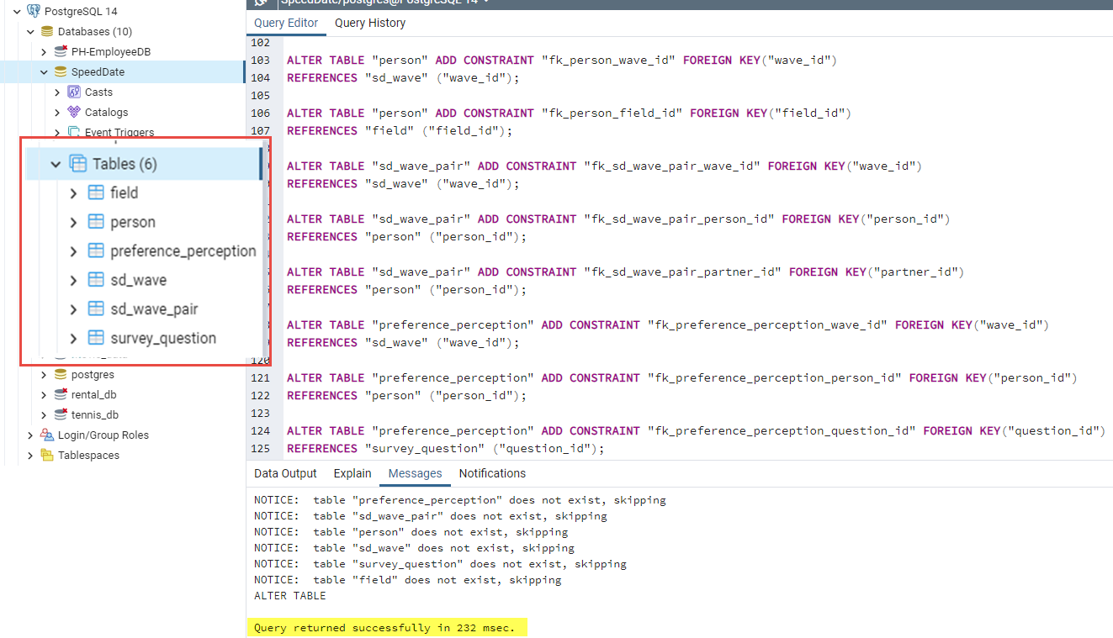
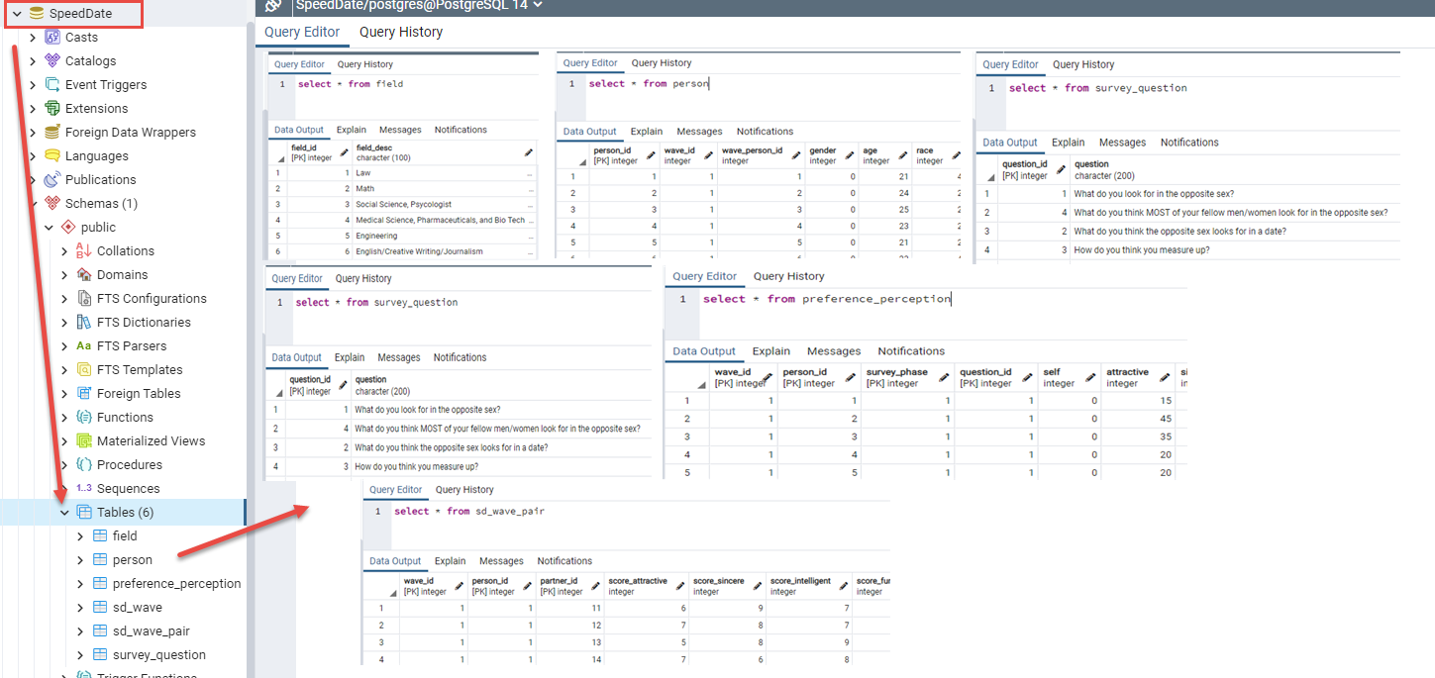
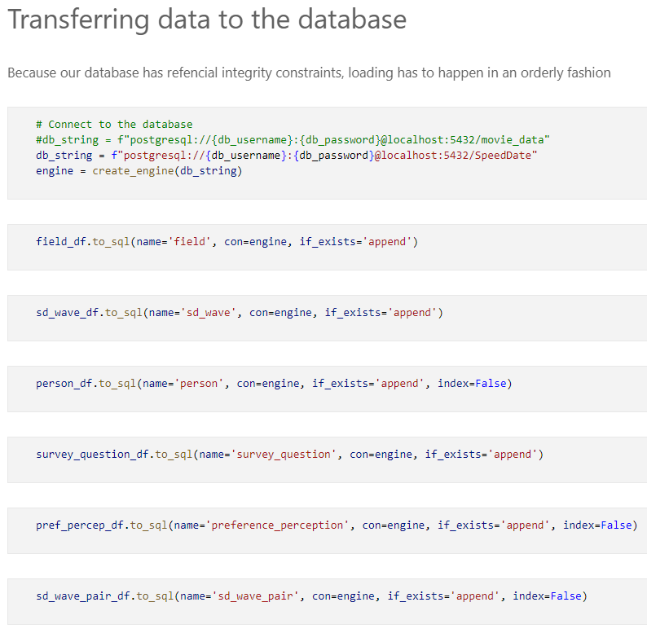
Database Creation (DB Name: SpeedDate)
Final Project 2022
Notes:
Ana: Database Creation, ERD Queries

Slide 7
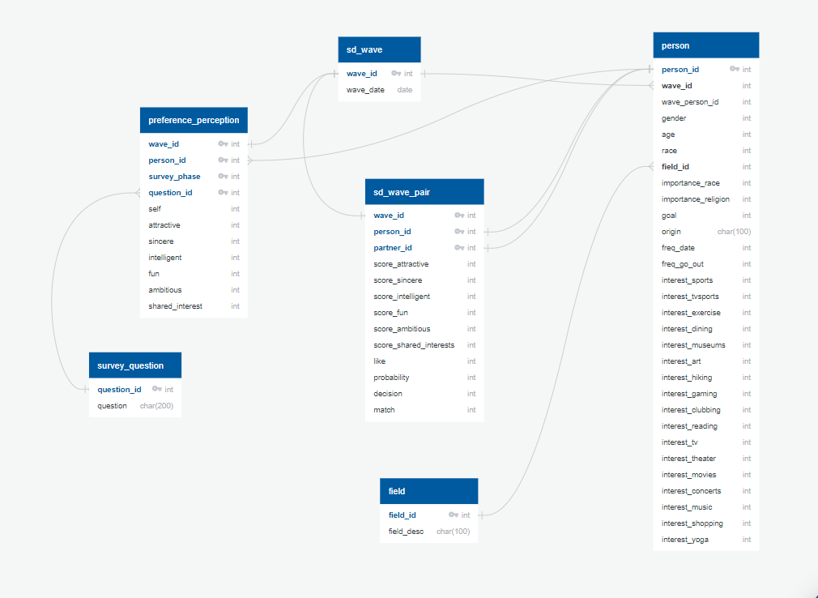
Database Creation (ERD)
Final Project 2022
Notes:
Ana: Database Creation, ERD Queries

Slide 8
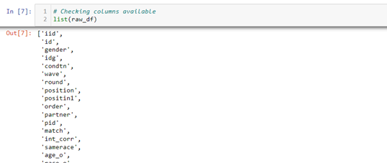
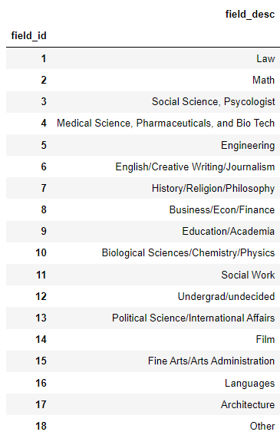
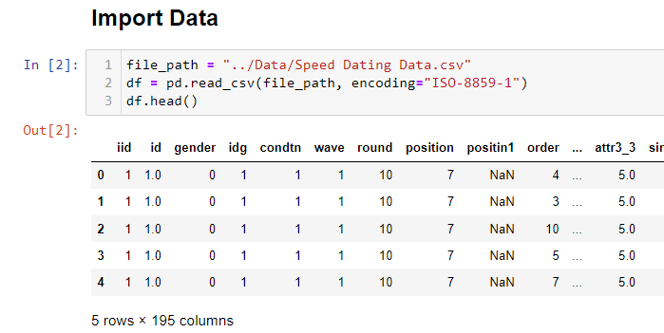
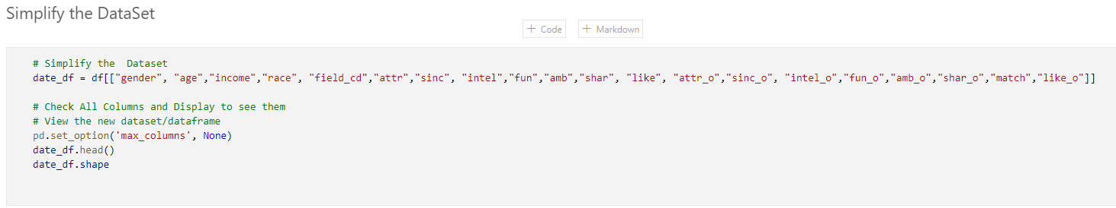
Data Exploration Phase Description
Final Project 2022
Notes:
Kristi: Data Exploration, Data Cleaning, Simplifying the dataset for model.

Slide 9
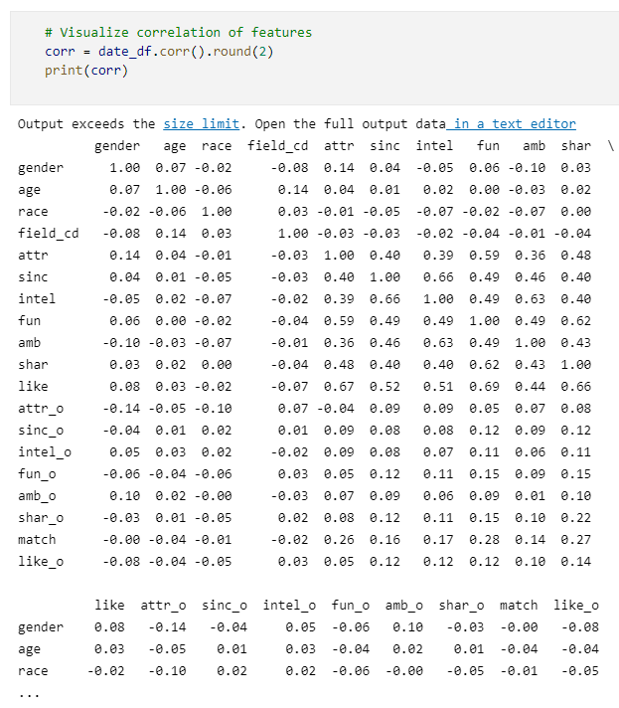
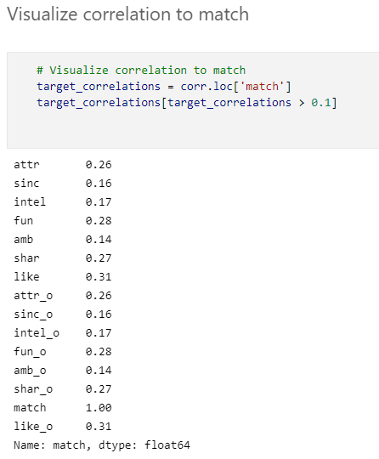
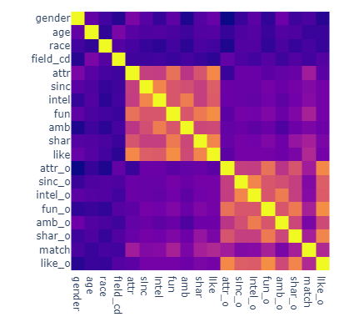
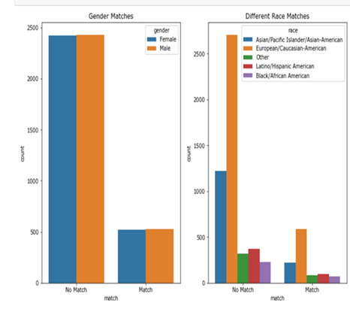
Analysis Phase Description
In supervised learning the algorithms use data that is labeled. The
algorithm determines which label should be given to new data by
associating patterns to the unlabeled new data. Classification
Predicts the category that the unlabeled new data belongs to.
Final Project 2022
Notes:
Kristi Discussion of model selection and why and how

Slide 10
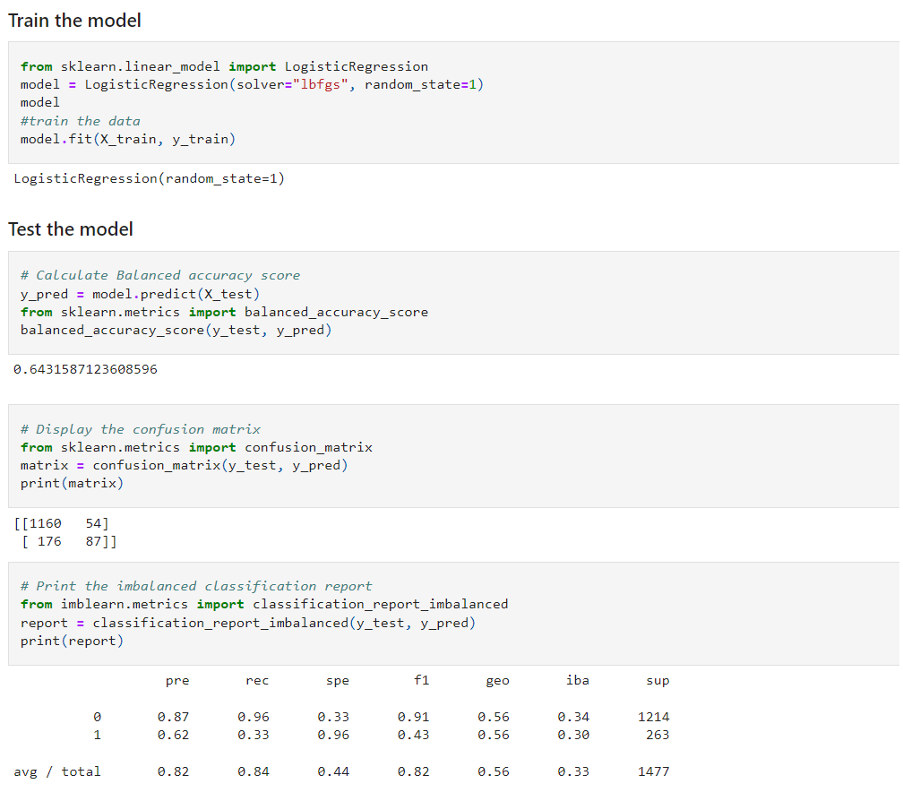
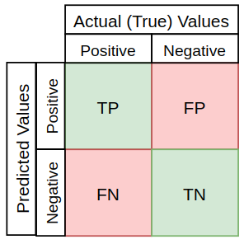
Results of Analysis
Logistic Regression Model
Training and Test Data: 80/20
Accuracy score: 64%.
The Classification Report showed
F1 score of .82
Precision score of .82
Recall Score of .84.
Final Project 2022
Notes:
Kristi:
Accuracy Score:
Precision Score:
Recall Score:
FI Score: harmonic mean of precision and recall

Slide 11
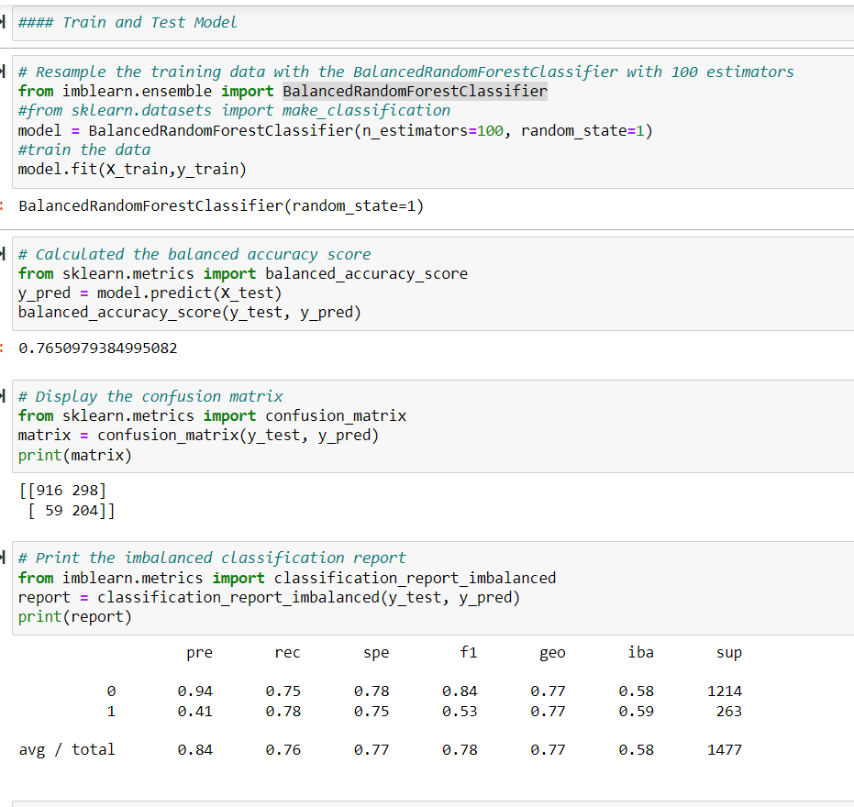
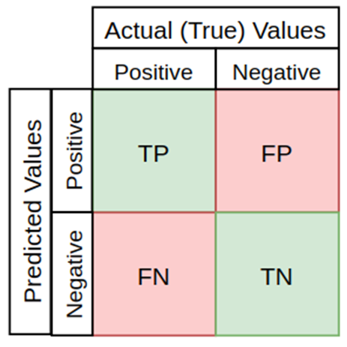
Results of Analysis
Balanced Random Forest Model
Training and Test Data: 80/20
Accuracy score of 77%
The Classification Report showed F1 score of .78
Precision score of .84
Recall Score of .76.
Final Project 2022
Notes:
Kristi:

Slide 12
Recommendations for future analysis
Further the feature engineering by selection of new features.
Final Project 2022
Notes:
Kristi: Recommendation for future analysis.

Slide 13






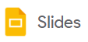

Technologies, Languages, Tools, and Algorithms
Development
Environment
Data
Management
Languages
Data
Visualization
Algorithms
Supervised Machine Learning
Logistic Regression
Balanced Random Forest
Final Project 2022
Notes:
David: Overview of technology used in project

Slide 14
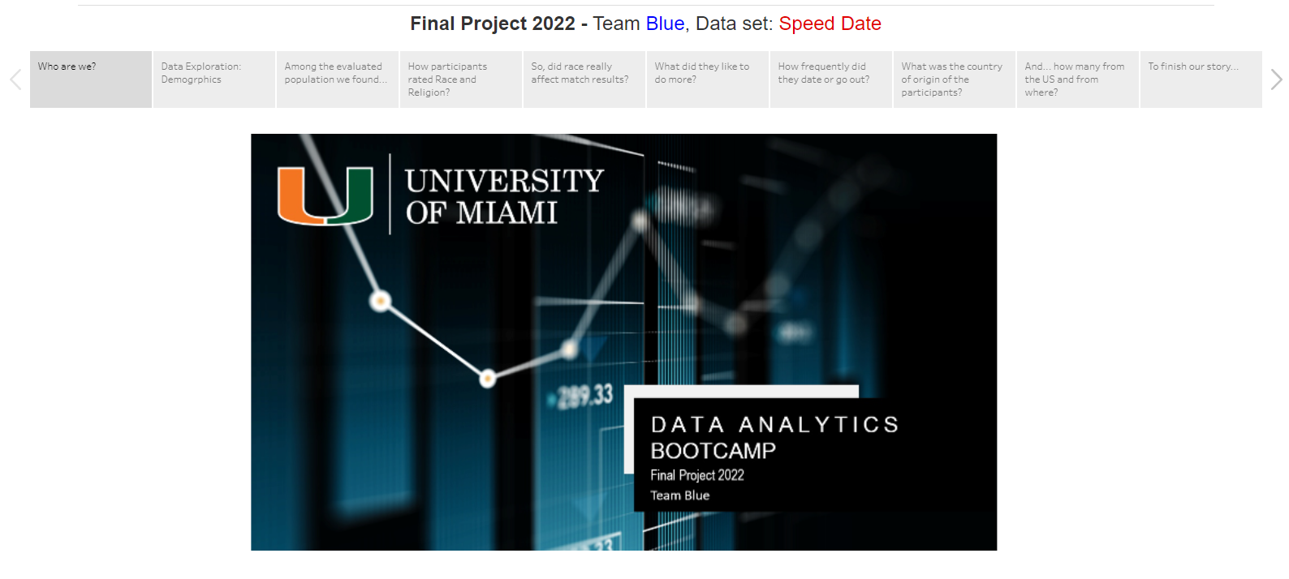
Dashboard Presentation
Final Project 2022
Notes:
David

